Slide 1
THE PATTERNS
OF ORGANIZATION

Slide 2
What are patterns of organization?
Organization
Details support a main or implied main idea
Authors often organize supporting details in a particular order…thus creating a pattern
Patterns are how the groups of supporting details are organized
Recognizing the patterns, of the organization of the supporting details, will help
  understand how an author thinks
  logically order the information
  begin predicting test questions

Slide 3
Types of Organizational Patterns
Organization
Chronological
Cause and Effect
Comparison and Contrast
Definition
Process

Slide 4
Chronological order is…
Organization
also known as time order, or sequence of events.
ideas are presented in the order in which they occur or take place in time.
Questions Answered:
  “When did it happen?”
  “In what order did it happen?”
When Used:
  Commonly used in history and narratives.

Slide 5
Example 1:
There have been many new inventions and improvements to photography that increased its proliferation into mainstream society. The availability of self-timers in the late 1880s allowed for an ease for creating self-portraits, since it gave five to ten seconds for the subject to position themselves in the shot. The launch of the portable Kodak Brownie Box camera in 1900 led to self-portraiture becoming a widespread technique. When instant cameras, such as the Polaroid became more affordable in the 1970s it encouraged photographers to take more self-portraits since the camera was very light, allowing it to be casually held at arms length and provided instant gratification. The proliferation of smartphones is responsible for the accessibility of cameras to the general public. The release of the Sony Ericsson Z1010 mobile phone in 2003 introduced the front-facing camera, which allowed for the easiest selfie-taking to date. In 2015, the Selfie Stick was invented, which allows for more of the background and additional people to be included in the composition.

Slide 6
Example 2:
See, bad things happen to me on field trips. Like at my fifth-grade school, when we went to the Saratoga battlefield, I had this accident with a Revolutionary War cannon. I wasn't aiming for the school bus, but of course I got expelled anyway. And before that, at my fourth-grade school, when we took a behindthe-scenes tour of the Marine World shark pool, I sort of hit the wrong lever on the catwalk and our class took an unplanned swim. And the time before that... Well, you get the idea.

Slide 7
Cause and Effect
Organization
Describes or discusses an event or action that is caused by another event or action. On occasion, this pattern is also referred to as result.
cause-effect relationships
  single cause - single effect
  single cause - multiple effects
  multiple causes - single effect
  multiple causes - multiple effects
Readings answer the questions:
  “Why did something happen?”
  “What were the results of a particular event?”

Slide 8
Focus on Effects
Organization
EFFECT #1
CAUSE
EFFECT #2
EFFECT #3

Slide 9
Focus on Causes
Organization
CAUSE #1
EFFECT
CAUSE #2
CAUSE #3

Slide 10
Cause and Effect Chain
Organization
CAUSE
EFFECT
CAUSE
EFFECT

Slide 11
Example 1:
It is not a fact that on which kind of device they are playing the games. The games can be both video games and the PC games. Both types of devices do attract them. There are several reasons why children love to play games. When they were asked that what interests them to play games so much, most of their answers were like it relaxes them and puts them out of their learning and homework pressures. In a way, they are quite true. Nowadays the kids are much pressurized with studies. Saying this I do not mean that studies are bad. No! It is simply that there should be a proper balance that should be maintained so that the kids find the time to recreate and refresh their minds.Another reason that most of the children have highlighted are that they can form teams with friends and enjoy the games. Yes, this is what you can call an advantage of today's technology. Games have become interactive. Team members can interact with each other, help them in games.
Article Source: http://EzineArticles.com/9612540

Slide 12
Example 2:
The COVID-19 pandemic has led to a dramatic loss of human life worldwide and presents an unprecedented challenge to public health, food systems and the world of work. The economic and social disruption caused by the pandemic is devastating: tens of millions of people are at risk of falling into extreme poverty, while the number of undernourished people, currently estimated at nearly 690 million, could increase by up to 132 million by the end of the year.
Millions of enterprises face an existential threat. Nearly half of the world’s 3.3 billion global workforce are at risk of losing their livelihoods. Informal economy workers are particularly vulnerable because the majority lack social protection and access to quality health care and have lost access to productive assets. Without the means to earn an income during lockdowns, many are unable to feed themselves and their families. For most, no income means no food, or, at best, less food and less nutritious food.

Slide 13
Comparison and Contrast
Organization
Text is organized to show relationship between two objects
emphasizes the similarities and/or differences between two or more items or topics..
Results in a meaningful analysis of what these differences and similarities mean
comparison means
  what things have in common
  how items or concepts are alike
  the similarities between elements or ideas
contrast means
  the differences between items or concepts
  how things are not alike
  distinctions between elements
Readings answer the questions:
  “How are these similar?”
  “How are these different?”
Thesis: Gangs and fraternities share many characteristics, but are quite different.

Slide 14
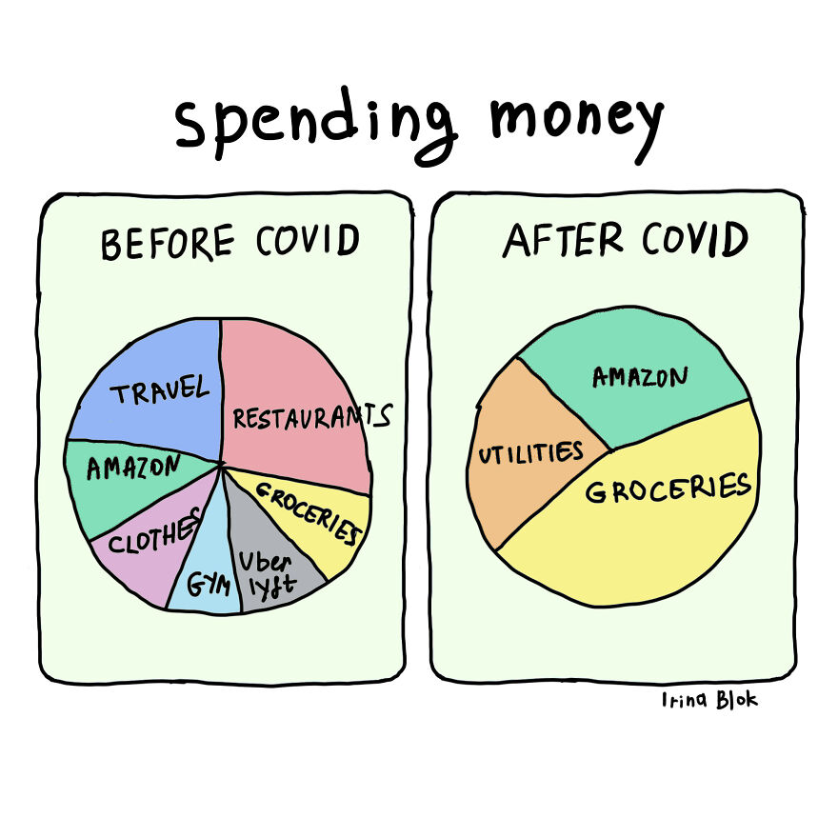

Slide 15
Ex
The story of the city mouse and the country mouse is one version of the age-old debate between the people who prefer city life and those who prefer country life. In the city there is always something to do. But in the country, you can always find peace and quiet. In the city, you are constantly exposed to new and different kinds of people. On the other hand, in the country, you are always among familiar faces. These are the images we have. The reality is less clear-cut. Rural towns do have their night spots, and even New York City has places to escape to and be alone with your thoughts.
  The main pattern of organization is:
  Transitions that signal the pattern:

Slide 16
Both Superman and Batman are heroes, but only one is truly a superhero, and taking into account their upbringing, motives, and criminal targets, that is Batman. Upbringing was not gentle for either. Superman came from Krypton, a planet that was about to self-destruct. His parents sent him as a baby on a spaceship to Earth. There he would be adopted by an ordinary farm family. His adoptive parents named him Clark Kent and reared him well. In the same generation, far away in Gotham, Bruce Wayne, the future Batman, was born to a contented, wealthy family. Tragically, his parents were killed in his presence during a mugging. He inherited the family wealth and was raised by his kindly butler. Those very different backgrounds provided Superman and Batman with powerful but different motives for fighting crime. Superman was programmed in his space capsule to know about the forces of good and evil on Earth and to fight the bad people. Unlike Superman, Batman learned from experience. Both have gone on to fight many bad people, but each one has a special enemy. For Superman, it is Lex Luthor, who has studied Superman and knows all about him, even his outstanding weakness—the mineral Kryptonite. For Batman, it is the Joker, who, as a wicked teenager, was the mugger-murderer of his parents. Many spectacular battles have ensued for both crime fighters, and one has reached the top in his profession. Superman offers overwhelming physical strength against crime, but Batman displays cunning and base passion. As he strikes fear in the hearts of the wicked, he’s not just winning; he is getting even. Most people would cheer Superman on, however, they would identify more with Batman, and he is the superhero. (From: Brandon & Brandon, 2011: 282-283).

Slide 17
Process
Details support the main idea as a list of steps, directions, or a sequence of stages in which a certain order is needed.
The steps/ stages lead up to a final product or finished project. Answers: “How?” “In what sequence or order?” “What are the steps of the process?”
“Not all stars are the same age, so it is possible to see stars at every stage of their life cycle.”
“There are several steps that must be followed if gold is to be efficiently extracted and refined from the bedrock in South Africa's Wit watersarnd region.”
Transitions:
accordingly, after that, begins, following steps, how to, in the process of, series, sequence, stages, then, first, second, third, next, last, finally

Slide 18
Make sure you know exactly who you want to see before hand. Then go to their official website to see where they will be performing. If you don't know the official website of the artist you want to see you can always Google their name and the official website should show up. From there you can find their tour schedule and decide on which date works for you. Try to pick a venue that is close to you and make sure that they are performing on a date that doesn't conflict with anything you have going on. The website should have tickets listed so you can purchase them directly from the source that is selling them. If the event you are looking for isn't listed don't worry. Just move on to the next step to find tickets. Usually an event isn't listed on the venue website because it is either sold out or too far ahead in the future.

Slide 19
Definition
Also called Statement and Clarification, a word or concept is introduced then explained or described. An example of its usage then follows. Answers: “What is it?”
“A solar eclipse is an astronomical event during which the Moon seems to cover the Sun.” “Repression is the mind’s power to block fearful thoughts, impulses, and memories. For example, a person may repress or forget painful childhood memories.”
Transitions
defined as, is, known, the term means, is stated as, is used to mean, for example, to illustrate, for instance, such as, sample, specifically, i.e., e.g.

Slide 20
What is woke?
Aside from being the past participle of wake, for decades, it meant conscious and aware – but the slang word has come to represent an embrace of progressive activism, as well. Merriam-Webster added the word to its dictionary in 2017, defining it as, "aware of and actively attentive to important facts and issues (especially issues of racial and social justice)." The Oxford dictionary adopted it the same year, defining it as "originally: well-informed, up-to-date. Now chiefly: alert to racial or social discrimination and injustice.“ But the meaning of woke evolved again with the rise of "cancel culture" -- as the two terms saw increased use, they became intertwined in the public consciousness. Often, someone gets canceled after they say something insensitive – something not woke.

